Slide 1
Software Products
Prof. Dr. Dirk Riehle
Friedrich-Alexander University Erlangen-Nürnberg
COSS B02
Licensed under CC BY 4.0 International
Notes:
It is Friedrich-Alexander University Erlangen-Nürnberg – FAU, in short.
Corporate identity wants us to say “Friedrich-Alexander University”.

Slide 2
Agenda
Software as a product
Intellectual property
Core product
Basic product
Whole product
Product architecture
Product life-cycle

Slide 3
1. Software as a Product

Slide 4
Software Products (Recap)
A software product
  Is a digital good (software, intellectual property)
  Is non-physical, does not rot
  Has near-zero copying costs
  Is a man-made artifact sold to customers in a market
  Has a life-cycle (is born, grows and matures, eventually dies)
  Is both extremely malleable and hard to change

Slide 5
Core, Basic, and Whole Product
Core product =
  Core software
  Additional functions
  Complementary artifacts
  Self-help services
Basic product =
  Core product +
  Fitness for use
  Certification
  Support services
Whole product =
  Basic product +
  Training
  Consulting
  Operations

Slide 6
Who Buys What When? [M91]
Innovators and
early adopters
Early majority
Late majority
and laggards
the chasm
time
core product
whole product

Slide 7
Whole product
Basic product
Core product (intellectual property)
Software
Core software
Additional software (extensions + plug-
ins, tools and utilities, integrations)
Complementary materials
Documentation
Training materials
Self-help services
Forums, mailing lists
Help and chat agents
On-line tutorials
Pricing of usage rights
Quantity: User, machine, time, …
Duration: Perpetual, time-limited, …
Structured: Initial license fee, regular subscription fee
Guarantees (“insurance”)
Fitness for use
Certification
Support services
Hot-line support
On-site servicing
Pricing of guarantees
By damage: Loss of business, fines received
Structured: Levels / bands, formula
Pricing of support services (SLAs)
By availability: Incident-based, 9x5, 24x7
By quality: First-level, second-level, third-level
Training
In-house training
Off-site training
Consulting
Technical implementation services
Strategic solution consulting
Operations
Provision of SaaS (managed service)
Pricing of training
Fixed fee
Per participating person
Pricing of consulting
Fixed fee
Time and materials
Pricing of operations
Quantity: Users, resources, …
Duration: Always time-limited
Structured: Set-up, subscription

Slide 8
2. Intellectual Property

Slide 9
Intellectual Property (IP)
Property
  Is some tangible or intangible entity
  Has an owner who has legal title to the property
Intellectual property is property that
  Is conceptual, i.e. non-tangible and usually non-fungible
  Is unique, i.e. not-a-commodity, not-interchangeable
Intellectual property rights are exclusion rights

Slide 10
Different Types of Intellectual Property (IP) and the Rights to it
IP | Right to IP
Textual (and other) articistic expressions | Copyright
Patents | Patent rights
Trademarks, smellmarks | Trademark rights
Trade secrets | Trade secret rights

Slide 11
Copyright
Copyright is a right to intellectual property
  For a specific expression, initially given to creator of work
  To exclude anyone from presentation, reproduction, modification
  It will eventually expire and the work will enter the public domain
Copyright law varies by jurisdiction
  Under U.S. law, can be signed over to third person
  Under German law (Urheberrecht) only usage rights can be granted
  Interpretation of one law in another jurisdiction is questionable
In software, examples of works that can be copyrighted are
  User interface designs
  Database schemata
  Source code

Slide 12
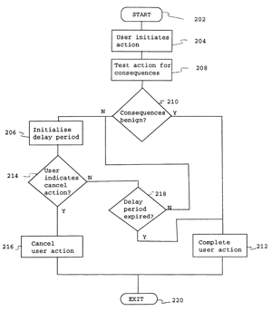
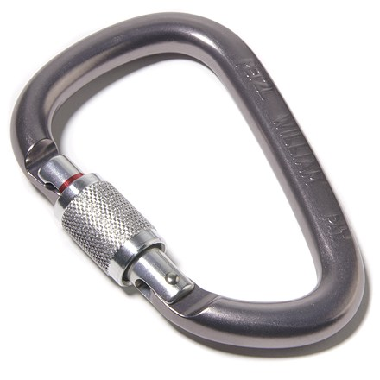
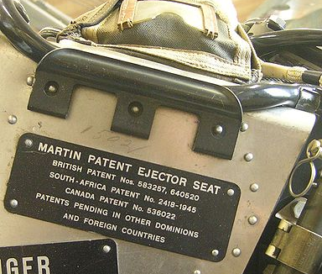
Patent Rights
A patent right is a right to intellectual property
  For a non-obvious industrial invention
  To exclude anyone from using the invention
  It will eventually expire; invention will enter the public domain
Patent right goal is foster innovation by motivating disclosure

Slide 13




Trademark Rights
Trademark rights are a right to intellectual property
  For a distinctive textual or visual sign, smell, sound
  To exclude anyone from using the sign, smell, sound
  They never expire, if registered and enforced (“use it or lose it”)

Slide 14
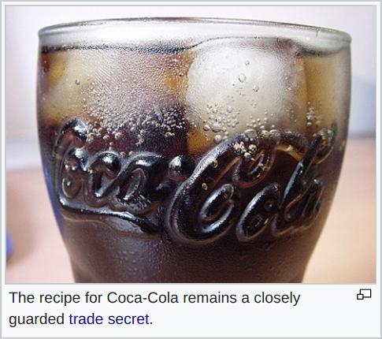
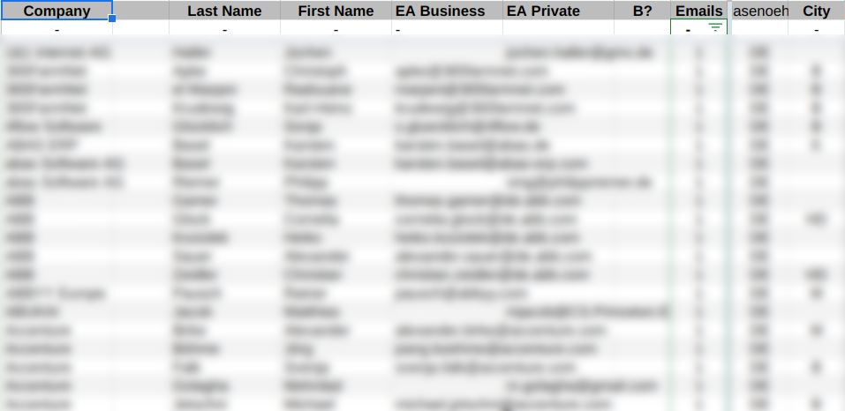
Trade Secret Rights
Trade secret rights are a right to intellectual property
  Which has not been disclosed (is secret) and has inherent economic value
  To exclude anyone from using the intellectual property (based on illicit access)
  Trade secret rights do not expire as long as reasonable protective measures are taken

Slide 15
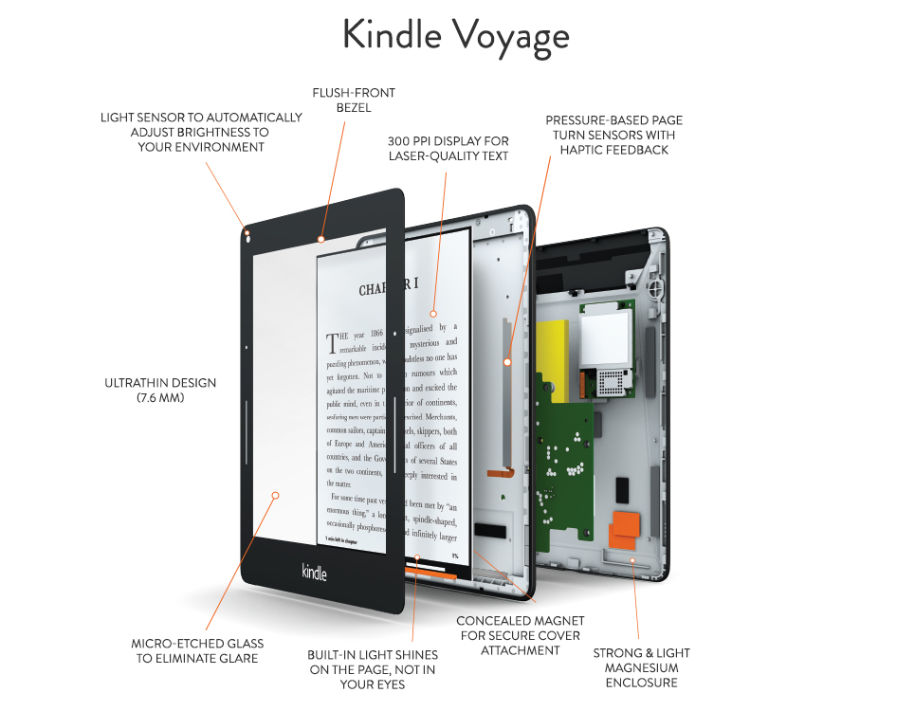
Identify the Intellectual Property

Slide 16
Exclusion Rights in Comparison
 | Copyright | Patent Rights | Trademark Rights | Trade Secret Rights
Form | Text, other specific expressions of non-trivial complexity | Abstract idea that represents a non-trivial industrial invention | Equivalence set of uniquely identifiable expressions | Any secret intangible artifact of inherent economic value
Purpose | To promote otherwise unprotectable artistic expression | To spur innovation by motivating the disclosure of trade secrets | To protect consumers from confusion by providing unique marks | To aid the competitiveness of the trade secret owner
Duration | Will eventually expire, but only after several decades | Will expire, but only after a few decades (shorter than copyright) | Will not expire as long as it is enforced by trademark owner | Will not expire as long as proper measures of protection are taken
Granting | Automatic by creation | By application to patent office | Automatic by creation, but can be registered as well | Automatic by creation

Slide 17
3. Core Product

Slide 18
Core Product
Core product =
  Core software
  Additional functions
  Complementary artifacts
  Self-help services
Basic product =
  Core product +
  Fitness for use
  Certification
  Support services
Whole product =
  Basic product +
  Training
  Consulting
  Operations

Slide 19
License
A license is a rights grant (a contract in most jurisdictions)
  Between a licensor and a licensee that
    Lets the licensee do specified things with
    Some tangible or intangible property
The rights grant may
  Allow use, modification, reproduction, ...
  Be perpetual, irrevocable, worldwide, …
The most common license type is the EULA
  EULA = End-user License Agreement

Slide 20
Software License
A software license is a license that
  Defines a rights grant to some piece of software
  Is typically based on copyright, trademarks, and patents

Slide 21
Four Example Products
Spotify
Hootsuite
In-the-cloud
Delivery
Tetris
Renderman
On-premise
Consumer
Enterprise
Market

Slide 22
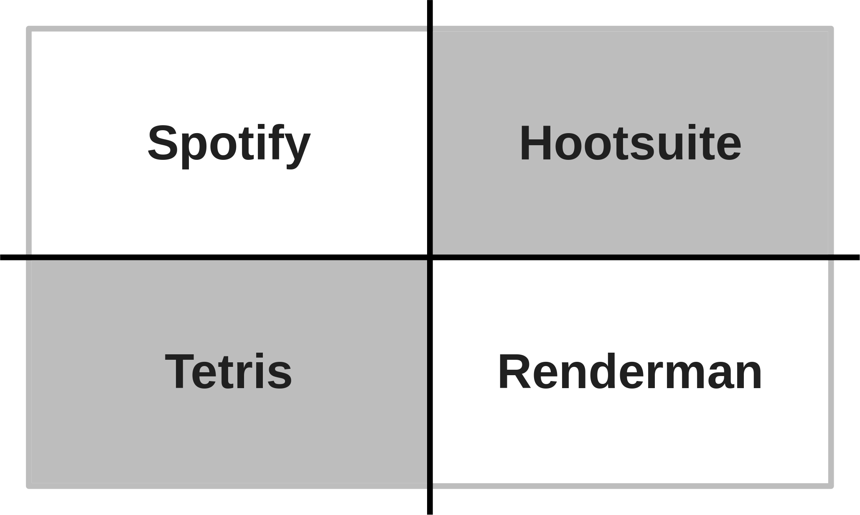
Software (Core Product 1 / 3)
Core software
Additional functions
  Extensions and plug-ins
  Tools and utilities
  Integrations with other software

Slide 23
Complementary Materials (Core Product 2 / 3)
Documentation
Training materials

Slide 24
Self-Help Services (Core Product 3 / 3)
Forums and mailing lists
Chat and help agents
On-line training

Slide 25
Pricing of Core Product
By consumption
  Number of users
  Number of cores / processors / machines
  Amount of time consumed
By availability
  Perpetual
  Time-limited (e.g. one year)
  Only on Halloween at 6:66am
Structured as
  Initial license fee
  Regular subscription fee
  Prepaid, postpaid, some other time

Slide 26
4. Basic Product

Slide 27
Basic Product
Core product =
  Core software
  Additional functions
  Complementary artifacts
  Self-help services
Basic product =
  Core product +
  Fitness for use
  Certification
  Support services
Whole product =
  Basic product +
  Training
  Consulting
  Operations

Slide 28
Fitness for Use (Basic Product 1 / 3)
Fitness for use is the fitness of the product for described uses
  In case of unfitness, vendor typically has (right) to fix problem
  Provides bug fixes within defined time
In case of continued unfitness (problem can’t be fixed)
  Vendor may have to compensate loss of business
  Pay a defined penalty (typically a function of original contract value)
Not priced but implied (priced-in)
  Vendor typically tries to negotiate it away

Slide 29
The Meaning of “Maintenance”
Maintenance (the more traditional term for “subscription”)
  Is the provision of bug fixes to customers
  Pro-actively or in response to bug reports
Legally speaking, vendors are making good on “fitness for use”

Slide 30
Certification (Basic Product 2 / 3)
Certification is a guarantee of a specifically defined fitness for use
  Hardware
  Software
Is provided by a
  Certification agency
  Complementary product vendor
Is often a purchase requirement

Slide 31
Support Services (Basic Product 3 / 3)
Support services
  In-person / on-site
  Hotline (voice)
  E-mail
  Chat
  Forums
Pricing can be by
  Channel
  Consumption
  Availability (9x5, 24x7)
  Quality (first, second, third-level support)

Slide 32
5. Whole Product

Slide 33
Whole Product
Core product =
  Core software
  Additional functions
  Complementary artifacts
  Self-help services
Basic product =
  Core product +
  Fitness for use
  Certification
  Support services
Whole product =
  Basic product +
  Training
  Consulting
  Operations

Slide 34
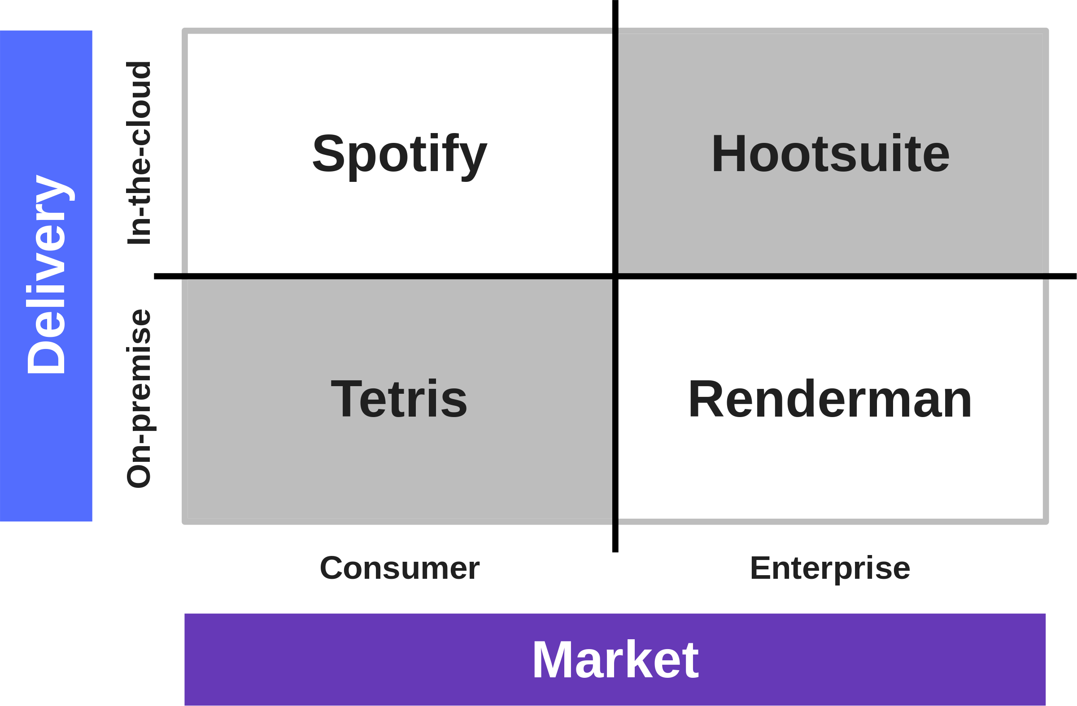
Enterprise vs. Consumer Markets
“Some people spend time to save money, some spend money to save time.” [M10]

Slide 35
Training (Whole Product 1 / 3)
There are two variants of training
  In-house training
    Vendor holds training at customer location
  Off-site training
    Users attend training at vendor location
Pricing of training
  Fixed fee
  Per person
  By volume

Slide 36
Consulting (Whole Product 2 / 3)
Consulting is the provision of
  Technical implementation services
  Strategic solution consulting
Pricing of consulting is by
  Fixed fee
  Time and materials

Slide 37
Operations (Whole Product 3 / 3)
Operations is the provision of (the) software-as-a-service
Pricing is similar to usage rights
  By consumption
    User, resources, time, …
  Structured as
    Set-up free, subscription fee
  Duration
    Limited in time, life-time subscription

Slide 38
6. Product Architecture

Slide 39
Intellectual Property View of Product Architecture 1 / 2
Products consist of components
  Software components
  Hardware components
Components embed various forms of intellectual property
  Open source software (copyright)
  Algorithms (patents)
  Implied trust (trademarks)
Products need to conform with legal and de-facto standards
  Implies more licenses to other people’s IP is needed

Slide 40
Intellectual Property View of Product Architecture 2 / 2
Who owns what?
  What third-party components do you need?
How to license it?
  At what cost?
How will it change in the future?
  Will there be alternatives?
Is it FRAND [1]? Is it open (source)?
[1] FRAND = “Fair, reasonable, and non-discriminatory”

Slide 41
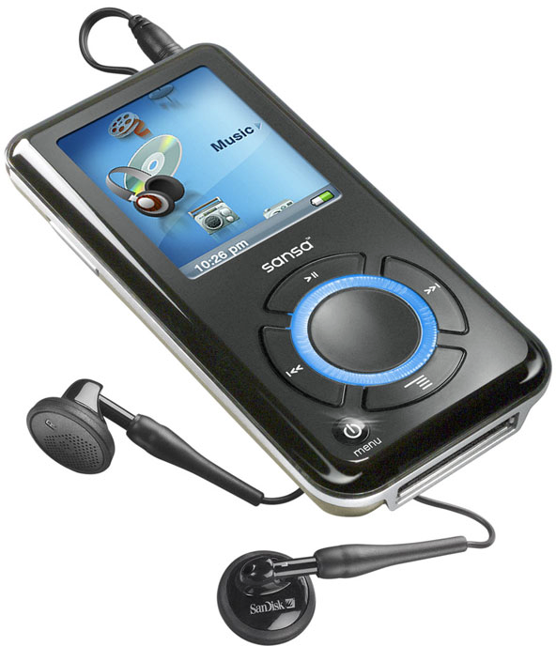
An Example IP-View of a Product Architecture
Component | Type | Owner | Rights sold
 | Physical parts | Vendor | Ownership
 | Source code | Vendor | Usage rights
 | MP3 patent | Fraunhofer IIS | Usage rights

Slide 42
7. Product Life-Cycle

Slide 43
Basic Life-cycle Model of Products
maturity
growth
decline
birth
death
time

Slide 44
Advanced Topics
Product bundling
Complements
Partnerships

Slide 45
Summary
Software as a product
Intellectual property
Core product
Basic product
Whole product
Product architecture
Product life-cycle

Slide 46
Thank you! Questions?
dirk.riehle@fau.de – http://osr.cs.fau.de
dirk@riehle.org – http://dirkriehle.com – @dirkriehle
DR

Slide 47
Credits and License
Original version
  © 2020 Dirk Riehle, some rights reserved
  Licensed under Creative Commons Attribution 4.0 International License
Contributions
  None yet

